Slide 1
Jewish Antapologia in response to Mel gibson’s Apologia

Slide 2
Who the heck is Mel Gibson?
Braveheart
Lethal Weapon
Daddy’s Home 2
Mad Max

Slide 3
Who the heck is Mel Gibson?
Signs
What Women Want
The Patriot
Maverick

Slide 4
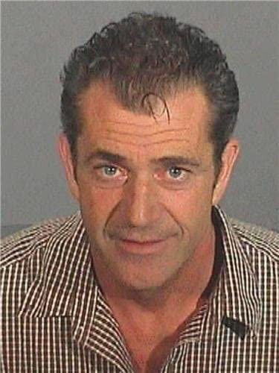
What Happened?
Pulled Over for Speeding
Blew a .12 on the Breathalyzer Test
Gibson Refused To Get in Police Car
Spouted Racist Comments to the Police

Slide 5
Fallout from Gibson’s Arrest
Some critics brought up his 2004 film Passion of the Christ and said it was more proof he was racist
ABC canceled a development deal with Gibson to create a mini-series on the Holocaust
Jewish Actor Rob Schneider said, “ Even if Apocalypto is a gigantic smash and Mr. Gibson is quietly forgiven by Hollywood Power Brokers, and I was offered a lead role opposite Mel Gibson’s Father (the Mad Max of Holocaust deniers), I would likely have to say no.”

Slide 6
Mel Gibson’s Image Repair
Statement released through his publicist:
I acted like a person completely out of control when I was arrested, and said things that I do not believe to be true and which are despicable. I am deeply ashamed of everything I said. Also, I take this opportunity to apologize to the deputies involved for my belligerent behavior. They have always been there for me in my community and indeed probably saved me from myself. I disgraced myself and my family with my behavior and for that I am truly sorry. I have battled with the disease of alcoholism for all of my adult life and profoundly regret my horrific relapse. I apologize for any behavior unbecoming of me in my inebriated state and have already taken necessary steps to ensure my return to health.
Image Repair Strategies: Defeasibility, Differentiation, Mortification, Corrective Action

Slide 7
Mel Gibson’s Image Repair
Another Statement, but this time to the Jewish Community:
“There is no excuse, nor should there be any tolerance, for anyone who thinks or expresses any kind of anti-Semitic remark. I want to apologize specifically to everyone in the Jewish community for the vitriolic and harmful words that I said to a law enforcement officer the night I was arrested on a DUI charge. I am in the process of understanding where those vicious words came from during that drunken display, and I am asking the Jewish community, whom I have personally offended, to help me on my journey through recovery. Again, I am reaching out to the Jewish community for its help.”
Image Repair Strategies: Defeasibility, Differentiation, Mortification, Corrective Action

Slide 8
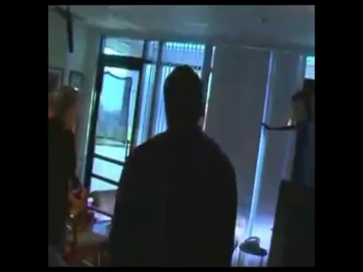
Mel Gibson Interview on GMA

Slide 9
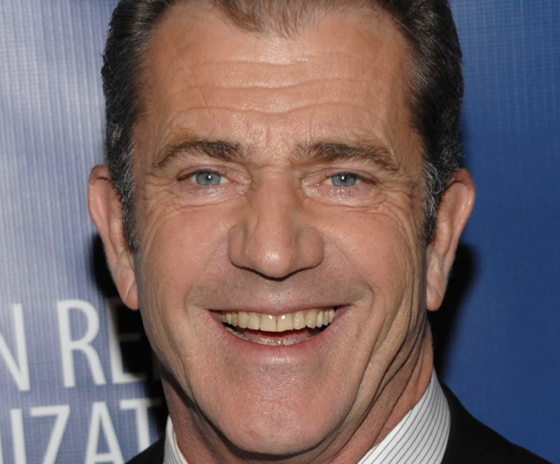
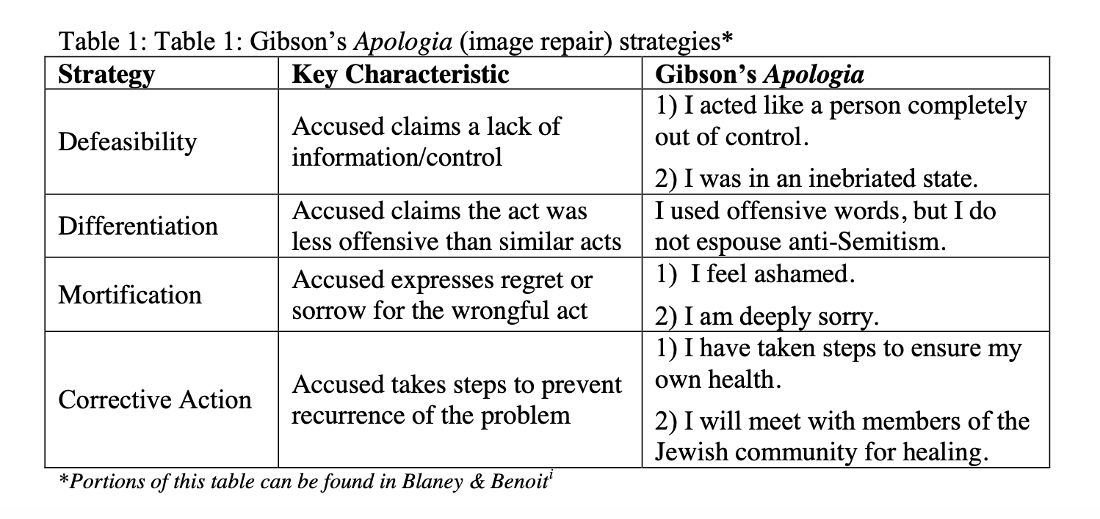
Mel Gibson’s Image REpair

Slide 10
Response to Gibson’s Image Repair
What is antapologia?
Why is it important?
Why does it need its own theory?

Slide 11
Antapologia Strategies
Strategy | Key Characteristic | Example
Strengthening the Kategoria (attack)
Identify Concessions | Shows What the Apologia Admits To | The man admitted the gun used in the robbery was his.
Refine the Attack | Modifies the Attack to Make It Stronger | You didn’t just damage my windshield, as I initially said, but also the headlights

Slide 12
Antapologia Strategies
Strategy | Key Characteristic | Example
Weakening the Apologia
Apologia is Untrue | Part of the Account is Untrue | He denied he was in the room at the time, but video surveillance shows otherwise.
Contradicted Previous Apologia Strategies | Current Strategies are Not Consistent with Previous Strategies | He denied that he punched the man, but later said he was provoked.
Apologia Does Not Take Adequate Responsibility | Apologia Does Not Meet the Accuser’s Demands | We will accept nothing short of a full apology, yet they continue to evade responsibility.
Apologia Reflects Character Flaws of the Accused | Apologia Highlights Negative Personal Traits of the Accused | Only a man devoid of morals would try to blame the victim’s family.
Defense Against Attacks Made in the Apologia | Accuser Responds to Attacks Made in the Apologia | She says the attack is motivated by greed, but I’m simply looking for justice.
Harm Will Come from Apologia Itself | The Discourse Itself Causes Harm in Addition to the Initial Act | His insincere apology sets a bad example for junior senators.
Arguing Motive Behind the Apologia | Accuser Argues There are Negative Motivations Behind the Apologia | You are only admitting responsibility because your staff told you to say this.
Arguing that the Apologia Mirrors Earlier Speeches and/or Events | The Accuser Says the Apologia is Comparable to Earlier Accounts | You always say you’re on a trip whenever you plan to meet up with your girlfriend.

Slide 13
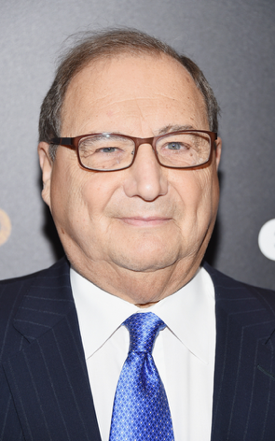
Jewish Antapologia Strategies
Strategy #1: Pointing Out Concession in the apologia
Abraham H. Foxman, National Director of the Anti-Defamation League, argued in his August 1st statement: “This is the apology we sought and requested. We are glad that Mel Gibson has finally owned up to the fact that he made anti-Semitic remarks, and his apology sounds sincere. We welcome his efforts to repair the damage he has caused, to reach out to the Jewish community, and to seek help.”
Foxman backpedals a bit in his August 2nd statement arguing: “I’m a little skeptical—we’ve been used as a P.R. tool before. But at this stage, we’ll take the high road and accept Mel Gibson’s apology at face value.”

Slide 14
Jewish Antapologia Strategies
Strategy #2: Arguing the apologia is Incomplete
For example, the American Jewish Committee issued the following statement on August 1st:
The American Jewish Committee welcomes Mel Gibson’s apology to the Jewish community, but true contrition must stand the test of time. In the Jewish tradition, we are very receptive of repentance, but complete repentance is measured by actions, not just words, over time. Mel Gibson’s anti-Semitic tirade when arrested for DUI last weekend was both outrageous and hurtful. While we appreciate his statement of apology, more importantly, we look forward in the months and years ahead to Gibson matching his contrition with his own deeds.

Slide 15
Jewish Antapologia Strategies
Strategy #2: Arguing the apologia is Incomplete
The Jewish Defense League also argued Gibson’s apologia was incomplete in an open letter to the actor on its website:
“The Jewish Defense League suggests two courses of action for you. If you wish to be a Jew-hater, come out and forthrightly articulate your true beliefs. There is no need to conceal these beliefs from Hollywood for fear of offending Hollywood Jews, since you’ve thoroughly ruined your reputation among them anyway.”

Slide 16
Jewish Antapologia Strategies
Strategy #2: Arguing the apologia is Incomplete
Foxman’s (ADL) first statement (August 1st):
“Once he [Gibson] completes his rehabilitation for alcohol abuse, we will be ready and willing to help him with his second rehabilitation to combat this disease of prejudice.”
Foxman’s second statement (August 2nd):
I’m still skeptical because these are still words from his handlers—the same people who brought you the first statement that didn’t acknowledge his anti-Semitism. I’d like to hear from the man himself. These words are still from his handlers—Mel Gibson’s words in the police blotter, we know those are from him.”

Slide 17
Jewish Antapologia Strategies
Strategy #2: Arguing the apologia is Incomplete
ADL’s Last Official Statement on Gibson:
“While there is an element of denial in his comments when he attributes anti-Semitic outburst to the alcohol, Gibson seems remorseful and ashamed of what he said during his arrest. He’s asking the right questions of himself, which is a first step on the road to recovery from prejudice.”

Slide 18
Jewish Antapologia Strategies
Strategy #2: Arguing the apologia is Incomplete
ADL’s Last Official Statement on Gibson:
“While there is an element of denial in his comments when he attributes anti-Semitic outburst to the alcohol, Gibson seems remorseful and ashamed of what he said during his arrest. He’s asking the right questions of himself, which is a first step on the road to recovery from prejudice.”

Slide 19
Jewish Antapologia Strategies
Strategy #3: Attributing motive to the apologia
The Jewish Defense League argued:
“Since that embarrassing slip-up [Gibson’s anti-Semitic remarks to Malibu police], you’ve issued two apologies, the second of which addresses the Jewish people directly. Your handlers obviously made you issue the second apology.”

Slide 20
Jewish Antapologia Strategies
Strategy #4: Arguing Harm will come from the apologia itself
Jewish Defense League provided the following statement:
The big problem is, Mel, your apologies are not convincing. They simply do not ring true. And in our eyes, all the false apologies and vehement denials of your true beliefs do a greater disservice to the Jewish community than if you were to simply confess proudly to those reprehensible views. Indeed, we would have greater respect for you if you were honest about hating us.

Slide 21
Conclusions
Pointing out concessions in the apologia made it harder for Gibson to backtrack from earlier statements
Arguing the apologia was incomplete would prevent Gibson from fixing his image with a few simple press releases. He would have to show changes to his character over years of effort.
Arguing that harm comes from the apologia itself is important because it establishes that Gibson can do even more harm with his language choices in addition to his initial racist words.
Attributing motive was effective because it called into question Gibson’s sincerity and whether he had ownership over his own apologia.

Slide 22
Conclusions
Racism might be one of the hardest offenses to repair. Perhaps there was nothing Gibson could have done to repair his image.
Because Gibson was a huge movie star, he needed to repair his image with multiple audiences and not just the Jewish community.
In a public opinion poll taken five days after Gibson’s first statement, participants were asked if they thought Mel Gibson was anti-Semitic or prejudiced against Jews. The majority (52%) felt that Gibson was not anti-Semitic, whereas 24 % had no opinion and 23% felt the actor was anti-Semitic.
In a poll conducted 11 days after Gibson’s first press release, participants were asked which part of the Mel Gibson incident they thought was the most offensive. The majority (50%) felt that the drunk driving was the worst part of the incident, while only 16% thought that Gibson’s comments about the Jews were the worst part.

Slide 23
Other Studies Using Antapologia
Stein, K. A. (2008). Apologia, antapologia and the 1960 Soviet U-2 incident. Communication Studies.
Turman, P. D., Stein, K. A., & Barton, M. H. (2008). The voice of the fan: Apologia, antapologia, and the 2006 World Cup Controversy.
Husselbee, L. P., & Stein, K. A. (2012). In the rough: Tiger Woods’ apology and journalistic antapologia. Journal of Sports Media.
Stein, K. A., Barton, M. H., & Turman, P. D. (2013). In the dark at Texas Tech: News coverage involving the image repair discourse of Mike Leach and Adam James. In J. R. Blaney, L. R. Lippert, & J. S. Smith (Eds.) Repairing the athlete’s image.
Stein, K. A., Barton, M. H., Ault, M. K., & Briscoe, J. R. (2013). Apologist-in-Chief?: Newspaper kategoria and antapologia following Barack Obama’s “Global Apology Tour.” Iowa Journal of Communication.
Kramer, M. R. (2013). The image repair media interview as apologia and antapologia: Marion Jones on the Oprah Winfrey Show. In J. R. Blaney, L. R. Lippert, & J. S. Smith (Eds.) Repairing the athlete’s image.
Sanderson, J., & Hambrick, M. E. (2016). Riding along with Lance Armstrong: Exploring antapologia in response to athlete adversity. Journal of Sports Media.
Harker, J. L. (2017). Flag on the play: A 5-year analysis of the kategoria and apologia that combine to incite journalistic antapologia in sports reporting. Communication & Sport.

