Slide 1
ANTAPOLOGIA FOLLOWING THE SLAP HEARD ROUND THE WORLD

Slide 2
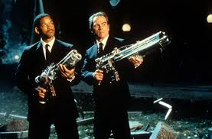
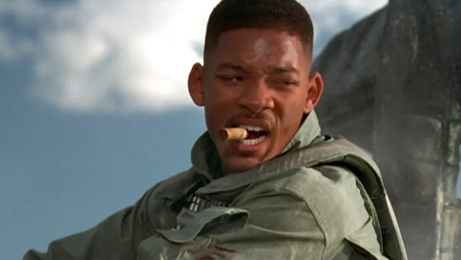
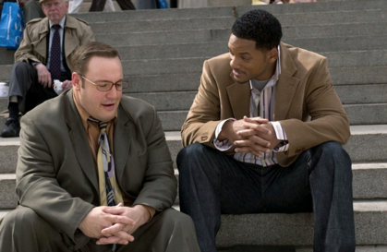
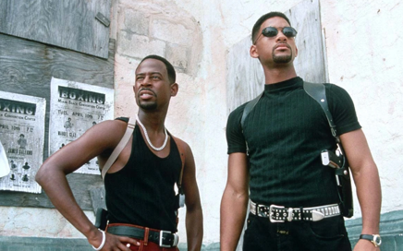
WHO THE HECK IS WILL SMITH?
Men in Black
Independence Day
Hitch
Bad Boys

Slide 3
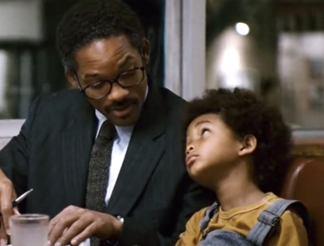
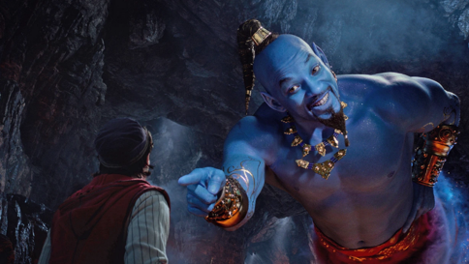
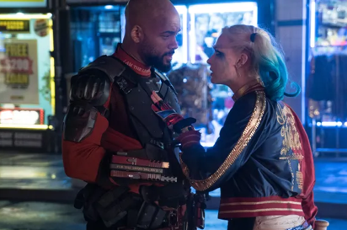
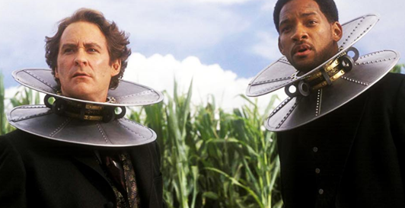
WHO THE HECK IS WILL SMITH?
Pursuit of Happyness
Aladdin
Suicide Squad
Wild Wild West

Slide 4
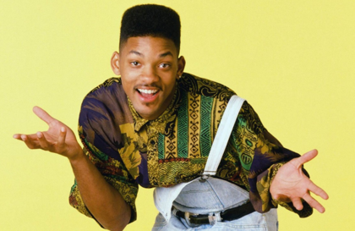
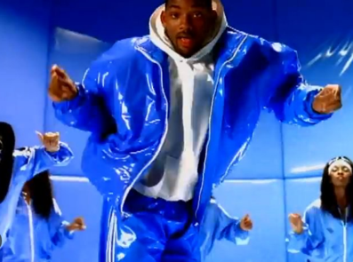
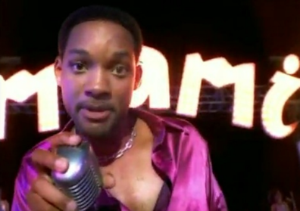
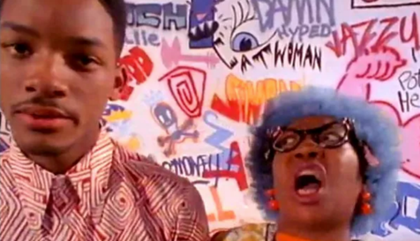
WHO THE HECK IS WILL SMITH?
Fresh Prince of Bel-Air
Gettin’ Jiggy Wit It
Miami
Parents Just Don’t Understand

Slide 5
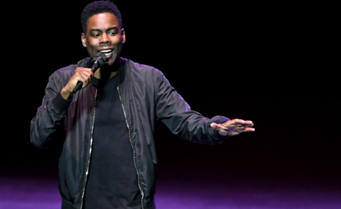
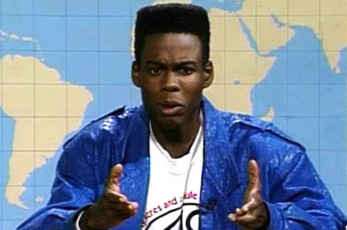
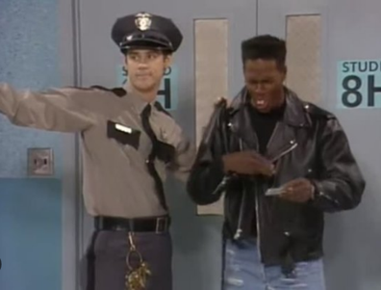
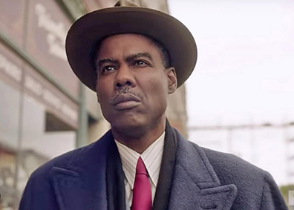
WHO THE HECK IS CHRIS ROCK?
Stand Up Comedian
Saturday Night Live
In Living Color
Fargo

Slide 6
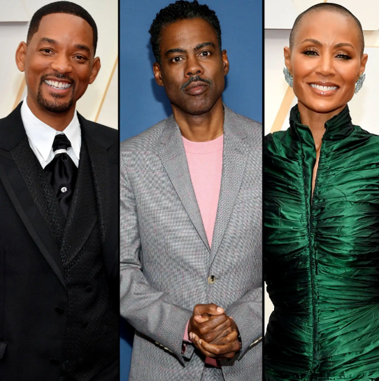
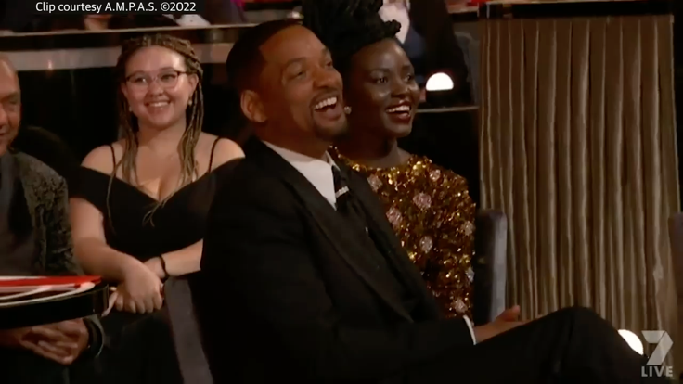
WHAT HAPPENED?

Slide 7
FALLOUT FROM THE SLAP
Son Jaden Smith tweeted out: “And that’s how we do it.”
Will Smith received the award for Best Actor for King Richard.
The Academy tweeted out the next morning that they don’t condone violence
Will Smith receives a 10 year ban from the Oscars (longest ever)

Slide 8
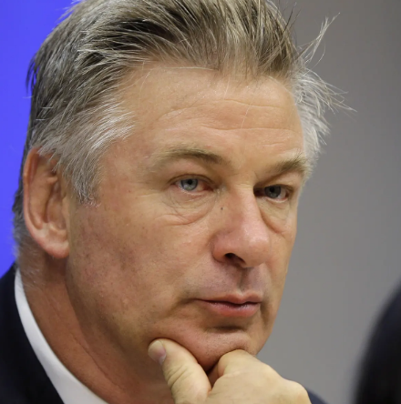

FALL OUT FROM THE SLAP
Alec Baldwin: “I am not reading much about how, or even if, the producers attended to Chris. But I love you, @chrisrock. And I’m sorry the Oscars turned into the Jerry Springer Show.”

Slide 9
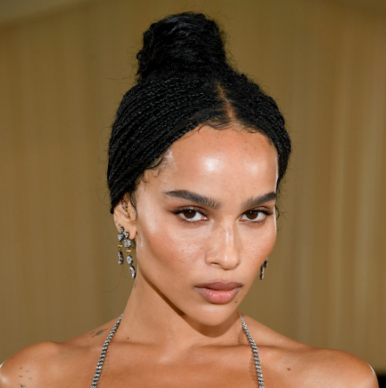

FALL OUT FROM THE SLAP
Zoe Kravitz: “Here’s a picture of my dress at the show where we are apparently assaulting people on stage now.”

Slide 10
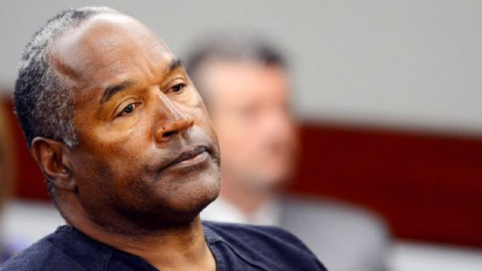
FALL OUT FROM THE SLAP
OJ Simpson: “It was unfortunate…I think Will was wrong…But you gotta accept, it’s humor. I didn’t think that was all that egregious. I thought it was a semi-funny joke.”

Slide 11
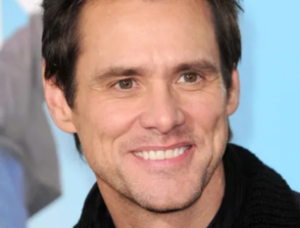
FALL OUT FROM THE SLAP
Jim Carrey: “I was sickened by the standing ovation…I felt like Hollywood is just spineless en masse and it really felt like, oh, this is a really clear indication that we’re not the cool club anymore…I’d have announced this morning that I was suing Will for $200 million because that video is going to be there forever."

Slide 12
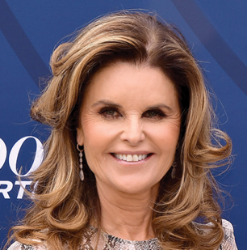
FALL OUT FROM THE SLAP
Maria Shriver: “We should never get to a place where we sit and watch a movie star hit someone on global television then, moments later, get a standing ovation while talking about love."

Slide 13
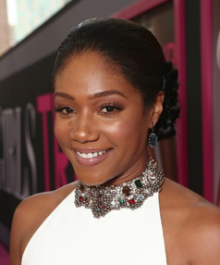
FALL OUT FROM THE SLAP
Tiffany Haddish: “When I saw a Black man stand up for his wife, that meant so much to me…As a woman, who has been unprotected, for someone to say, ‘Keep my wife’s name out of your mouth, leave my wife alone,’ that’s what your husband is supposed to do, right?"

Slide 14
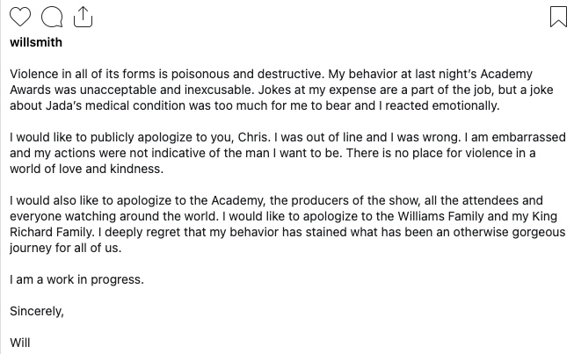
WILL SMITH’S IMAGE REPAIR
Image Repair Strategies: Mortification, provocation, bolstering, corrective action

Slide 15
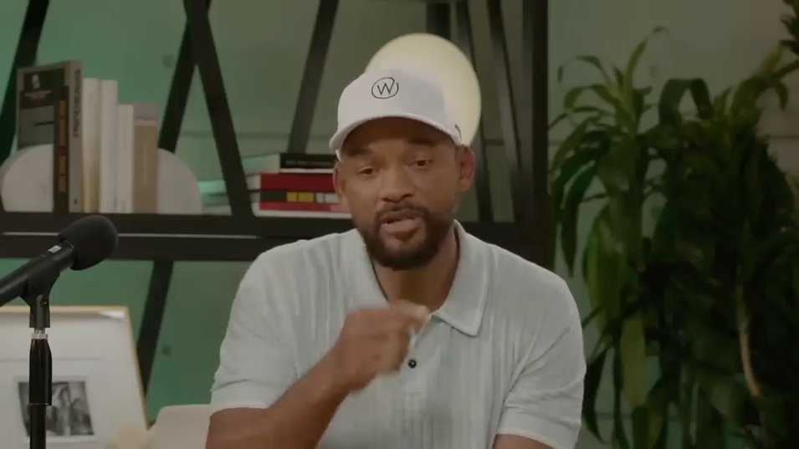
WILL SMITH’S IMAGE REPAIR
Image Repair Strategies: Mortification, Corrective Action

Slide 16
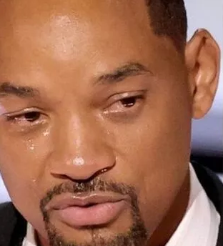
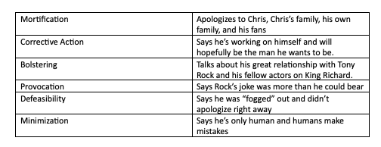
WILL SMITH’S IMAGE REPAIR

Slide 17
RESPONSE TO SMITH’S IMAGE REPAIR
What is antapologia?
Why is it important?
Why does it need its own theory?

Slide 18
ANTAPOLOGIA STRATEGIES
Strategy | Key Characteristic | Example
Strengthening the Kategoria (attack)
Identify Concessions | Shows What the Apologia Admits To | The man admitted the gun used in the robbery was his.
Refine the Attack | Modifies the Attack to Make It Stronger | You didn’t just damage my windshield, as I initially said, but also the headlights

Slide 19
ANTAPOLOGIA STRATEGIES
Strategy | Key Characteristic | Example
Weakening the Apologia
Apologia is Untrue | Part of the Account is Untrue | He denied he was in the room at the time, but video surveillance shows otherwise.
Contradicted Previous Apologia Strategies | Current Strategies are Not Consistent with Previous Strategies | He denied that he punched the man, but later said he was provoked.
Apologia Does Not Take Adequate Responsibility | Apologia Does Not Meet the Accuser’s Demands | We will accept nothing short of a full apology, yet they continue to evade responsibility.
Apologia Reflects Character Flaws of the Accused | Apologia Highlights Negative Personal Traits of the Accused | Only a man devoid of morals would try to blame the victim’s family.
Defense Against Attacks Made in the Apologia | Accuser Responds to Attacks Made in the Apologia | She says the attack is motivated by greed, but I’m simply looking for justice.
Harm Will Come from Apologia Itself | The Discourse Itself Causes Harm in Addition to the Initial Act | His insincere apology sets a bad example for junior senators.
Arguing Motive Behind the Apologia | Accuser Argues There are Negative Motivations Behind the Apologia | You are only admitting responsibility because your staff told you to say this.
Arguing that the Apologia Mirrors Earlier Speeches and/or Events | The Accuser Says the Apologia is Comparable to Earlier Accounts | You always say you’re on a trip whenever you plan to meet up with your girlfriend.

Slide 20
ANTAPOLOGIA STRATEGIES
SOME FUNNY THINGS CHRIS ROCK SAID AFTERWARDS THAT ARE NOT ANTAPOLOGIA
“I’m going to try to do a show tonight without offending nobody. I’m going to try my best, because you never know who might get triggered,”
“People always say words hurt. Anybody who says words hurt has never been punched in the face.”

Slide 21
ANTAPOLOGIA STRATEGIES
SOME FUNNY THINGS CHRIS ROCK SAID AFTERWARDS THAT ARE NOT ANTAPOLOGIA
“It still hurts. I got ‘Summertime’ ringing in my ears. But I’m not a victim, baby. You’ll never see me on Oprah or Gayle crying… I took that hit like Pacquiao.”
“I love Will Smith, my whole life. I have rooted for Will Smith my whole life … now I watch Emancipation just to see him get whupped.”

Slide 22
ANTAPOLOGIA STRATEGIES
SOME FUNNY THINGS CHRIS ROCK SAID AFTERWARDS THAT ARE NOT ANTAPOLOGIA
When asked why he didn’t fight back: “Because I got parents. You know what my parents taught me? Don’t fight in front of White people.”
When asked if it hurt: “Goddam right… the motherfu**er hit me over a bull**** joke – the nicest joke I ever told.”

Slide 23
ANTAPOLOGIA STRATEGIES
STRATEGY #1: APOLOGIA REFLECTS CHARACTER FLAWS OF THE ACCUSED
At a comedy set at London’s O2 Arena (September 3rd), Chris Rock said: “F**k your hostage video”
@dannyandnatalie: He nearly cracked a smile when he said I apologize that I slapped you.
@naggyguibman: Took Will 3 months to apologize, man. Question is, why now and why not back then?
@jerklobster7650: Why is he advertising his own water bottle brand during his apology?

Slide 24
ANTAPOLOGIA STRATEGIES
STRATEGY #2: APOLOGIA IS UNTRUE
On whether Smith reached out to Chris, his brother Tony said: “That wasn’t true, that wasn’t true. I think like, two nights later, he said, ‘I reached out to Chris, and he didn’t want to talk.’ That wasn’t true.”
@moorenicola6264: At the end, he says “I promise we’re gonna be friends again.” He doesn’t get to decide that. He’s changed public opinion forever and people will decide if they change their opinion of him. It’s not up to him.

Slide 25
ANTAPOLOGIA STRATEGIES
STRATEGY #3: ARGUING MOTIVE BEHIND THE APOLOGIA
@Eco-Pu2zs: There’s a difference between someone who is truly sorry and someone who is just trying to do damage control.
@ShaNewaz1: “Forgive me so my career stays perfect.”
@Justin-bg4jx: This feels like more of asking for forgiveness for himself than an apology to Chris.
@Francis_M: The reason he didn’t apologize in his acceptance speech is because he was still under the impression that what he did was proper and heroic. The apology now is because it didn’t turn out the way he’d hoped and there was a ton of backlash.

Slide 26
ANTAPOLOGIA STRATEGIES
STRATEGY #3: ARGUING MOTIVE BEHIND THE APOLOGIA
@WhyDidYoutubeDoThis: Man he still covering for her, like he didn’t laugh at the joke.
@c.m.9369: I can literally see the PR director’s instructions floating all over this video. Well shot. Well produced. Well edited. Well written. Really well done. And therefore really inauthentic.

Slide 27
ANTAPOLOGIA STRATEGIES
STRATEGY #4: APOLOGIA IS INCOMPLETE
Tony Rock in a radio interview: “He did what he did. He said what he said. I don’t know where he goes from here.”
@lagina1111: Don’t apologize to the public for what you did! Apologize to Chris for slapping him, to all the winners and presenters who got the spotlight taken away from them, to the academy for not leaving the room and making the most awkward scene in TV history, and to all of us for dragging us yet again into your personal issues.

Slide 28
ANTAPOLOGIA STRATEGIES
STRATEGY #4: ARGUING THE APOLOGIA IS INCOMPLETE
@brittniestafford6105: Saying “I want to apologize” and saying “I’m sorry” are two different things.
@FaithReconstructed91: If he said “Chris what I did was disgusting, disposable and unprofessional, and I am genuinely sorry for hurting you and others” instead of just “I apologize to you..” he would earn my respect because it would have sounded more authentic.
@bryantrujillo3155: Leave your wife is the first step. She’s despicable.
@vector853: Did he just say “Shame is not helpful?”

Slide 29
DISCUSSION QUESTIONS
Was Will Smith wrong to do what he did? What do you think of the offense?
Did Will Smith use the right strategies (Mortification, corrective action, defeasibility, bolstering, provocation, minimization)?
How effective were the key antapologia strategies (reflects character flaws, apologia is untrue, apologia is incomplete, motive behind apologia)?
What makes this context different from others? What were the rhetorical constraints on Will Smith and Chris Rock?

Slide 30
CONCLUSIONS
Yahoo News Poll on the offense itself: 67% believed Smith was wrong, 16% said he was right, and 17% weren’t sure. In another poll, 50% said it was never right to hit someone for insulting a loved one (35% said it was “always” or “sometimes” okay)
No polls conducted after the apology video. Why?
In April 2023, over a year after the slap, a Newsweek poll showed Will Smith was liked by 56% of respondents and disliked by 24%. Could be a result of the apology or just time passing and stored up “good will” he has with the audience.

Slide 31
OTHER STUDIES USING ANTAPOLOGIA
Stein, K. A. (2008). The 1960 Soviet spy plane incident
Turman, P. D., Stein, K. A., & Barton, M. H. (2008). The 2006 World Cup head butt.
Husselbee, L. P., & Stein, K. A. (2012). Newspaper antapologia following Tiger Woods’ image repair
Stein, K. A., Barton, M. H., & Turman, P. D. (2013). News antapologia after Mike Leach locked Texas Tech player Adam James in a closet.
Stein, K. A., Barton, M. H., Ault, M. K., & Briscoe, J. R. (2013). Antapologia in response to Barack Obama’s ”World Apology Tour”
Kramer, M. R. (2013). Antapologia in response to Marion Jones image repair following the use of performance-enhancing drugs
Sanderson, J., & Hambrick, M. E. (2016). Antapologia following Lance Armstrong’s cheating during the Tour de France
Harker, J. L. (2017). 5-year analysis of antapologia in sports reporting of various scandals.

