Slide 1
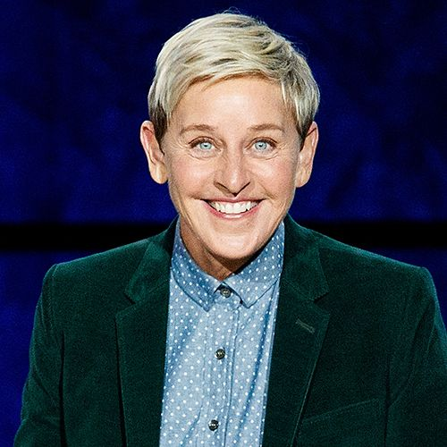

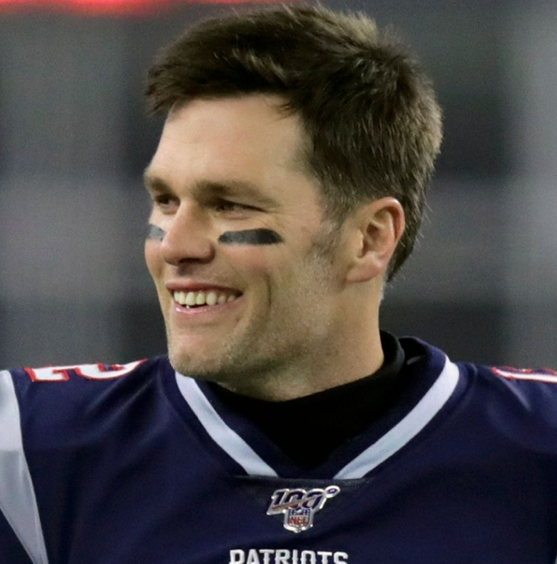
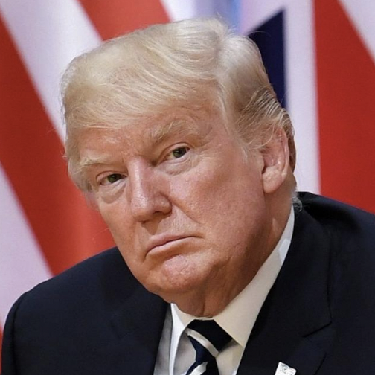
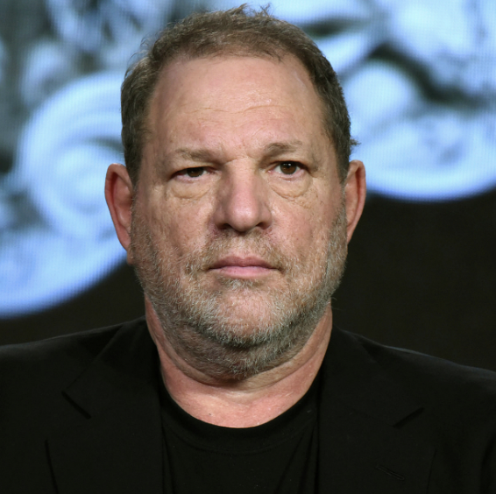

Image Repair and Public Scandal
Persuasive Strategies Used by Public Figures to Repair Image Following Harmful Acts
Dr. Kevin Stein
Southern Utah University

Slide 2
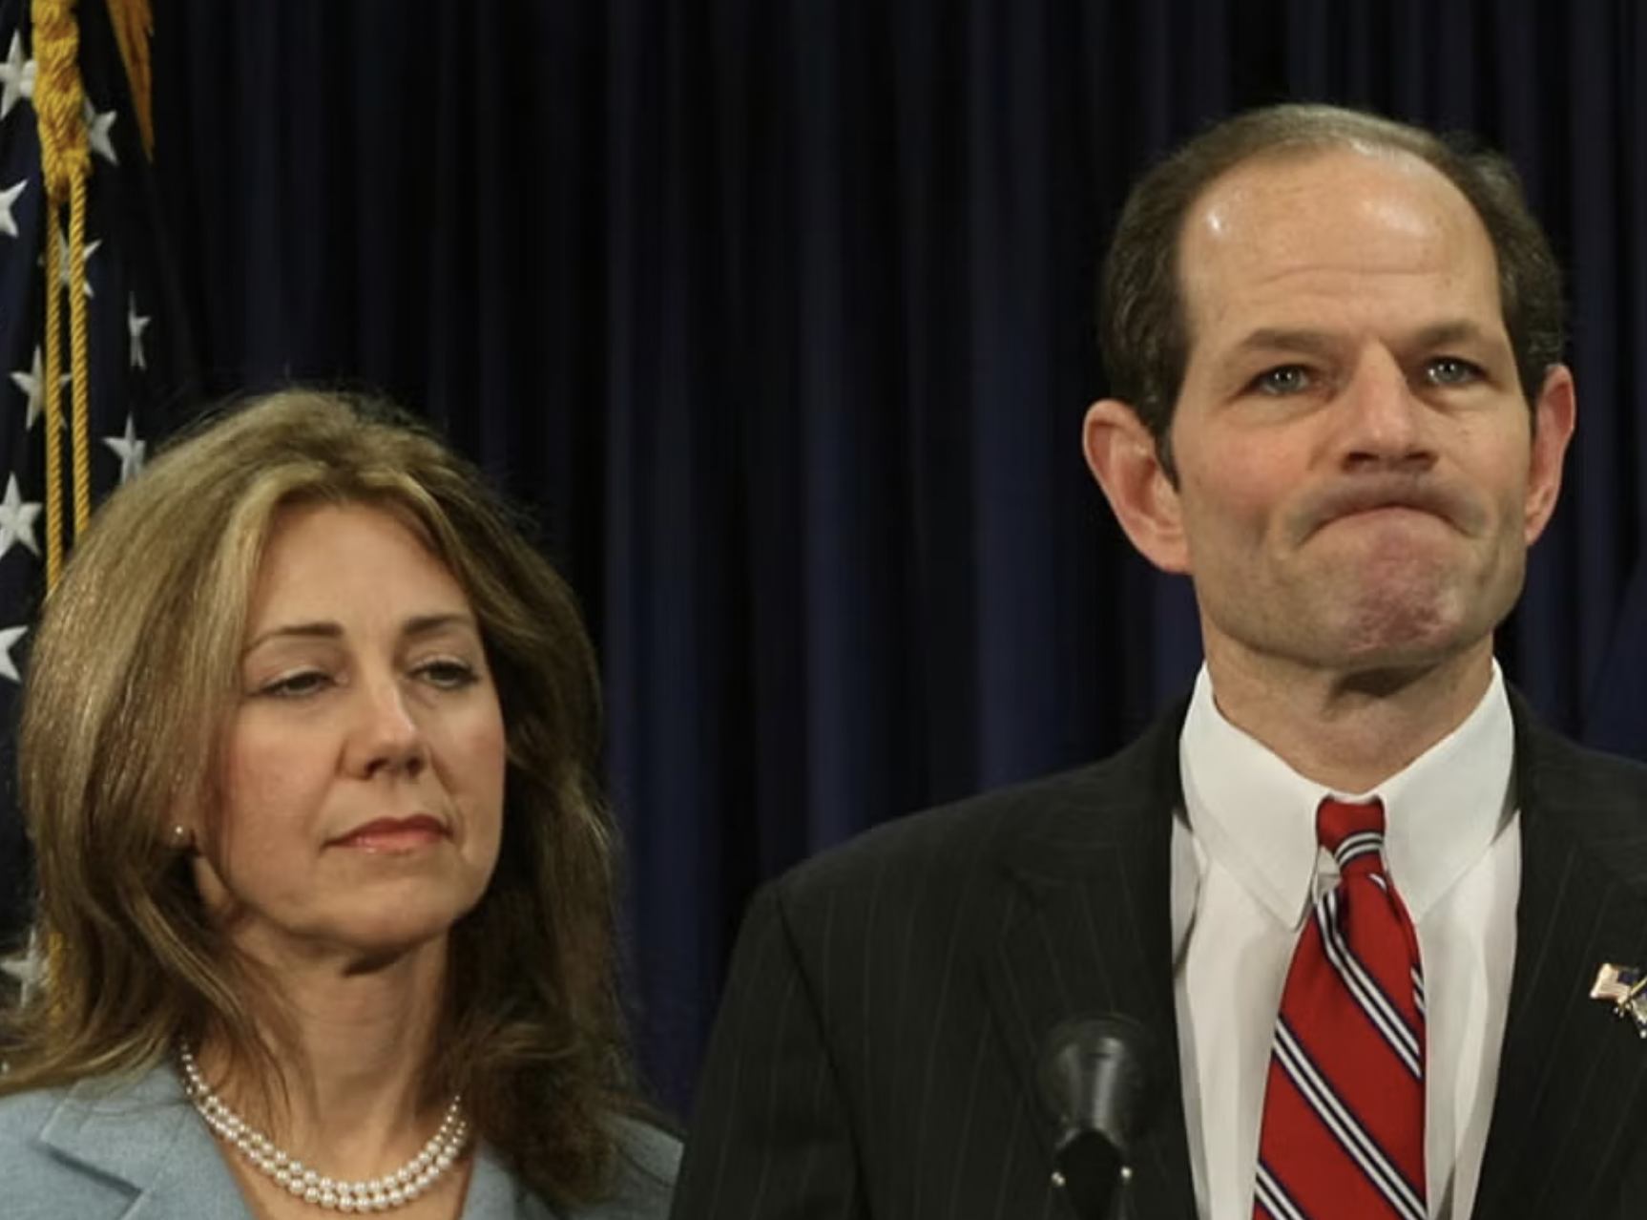
What is image repair?
“Image” is the public persona or apparent character of a person or organization.
Accusations or suspicions of wrongdoing threaten that reputation and require repair.
Image repair is synonymous with apologia.

Slide 3

Why is image important?
Impacts our self-esteem
Affects our interpersonal relationships with others
Impedes our opportunities for success
Affects corporate and stakeholders
Image is rooted in perception and not always truth

Slide 4
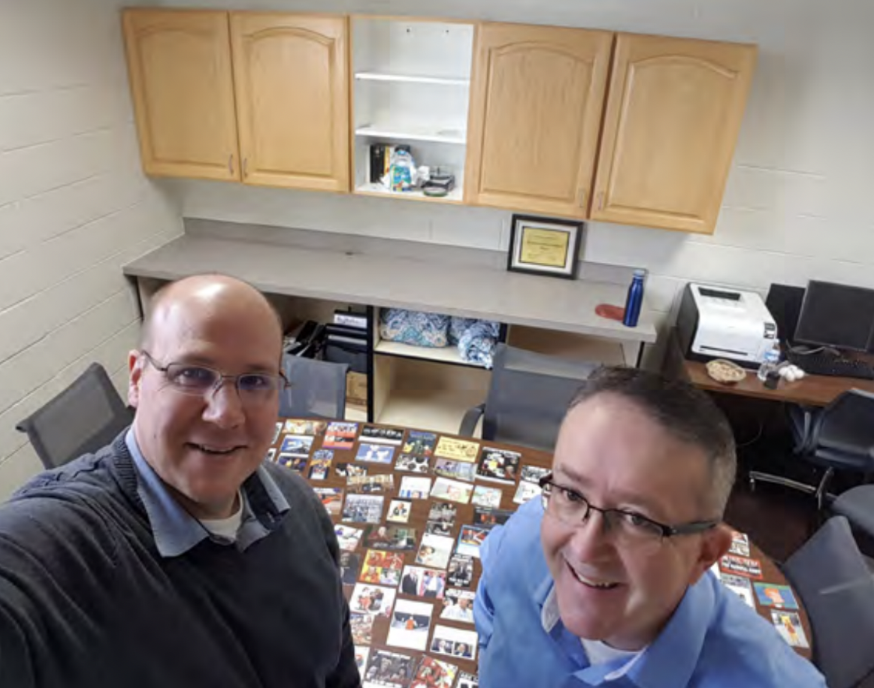
Stein’s Image Repair Research
Tonya Harding’s olympic scandal
Filmmaker apologia after making bad movies
Athletes after losing important games
Student email excuses to their professor
Tiger Woods’ infidelity
Mel Gibson’s drunken anti-Semitic tirade
Zinedine Zidane’s headbutt at the 2006 World Cup
U.S. apologia after the 1960 Soviet spy plane incident
Surrogate apologia of the families of deceased musicians (in progress)

Slide 5
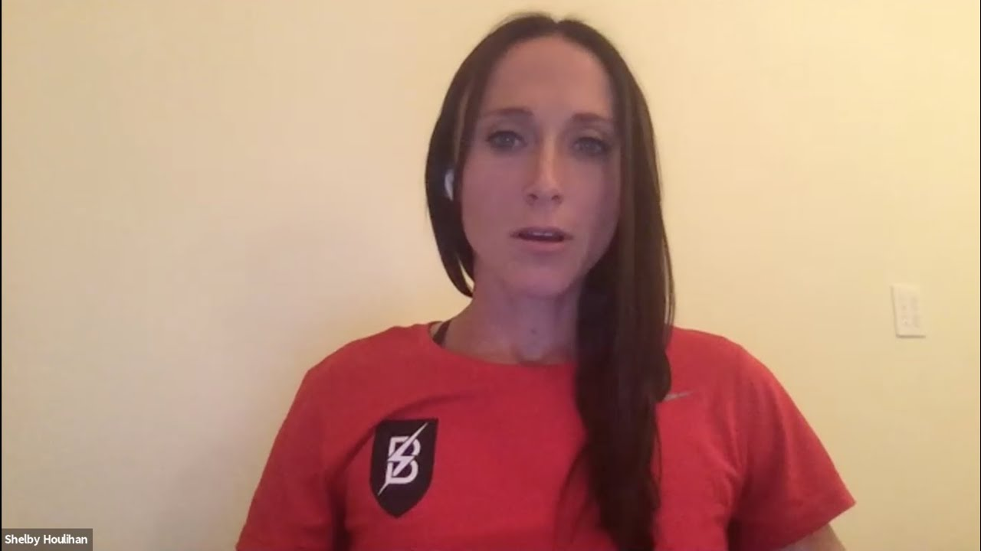
Benoit’s Image Repair Theory (Apologia)
Denial - Person claims they didn’t do it
Shelby Houlihan: “I want to be clear. I have never taken performance-enhancing drugs.”

Slide 6
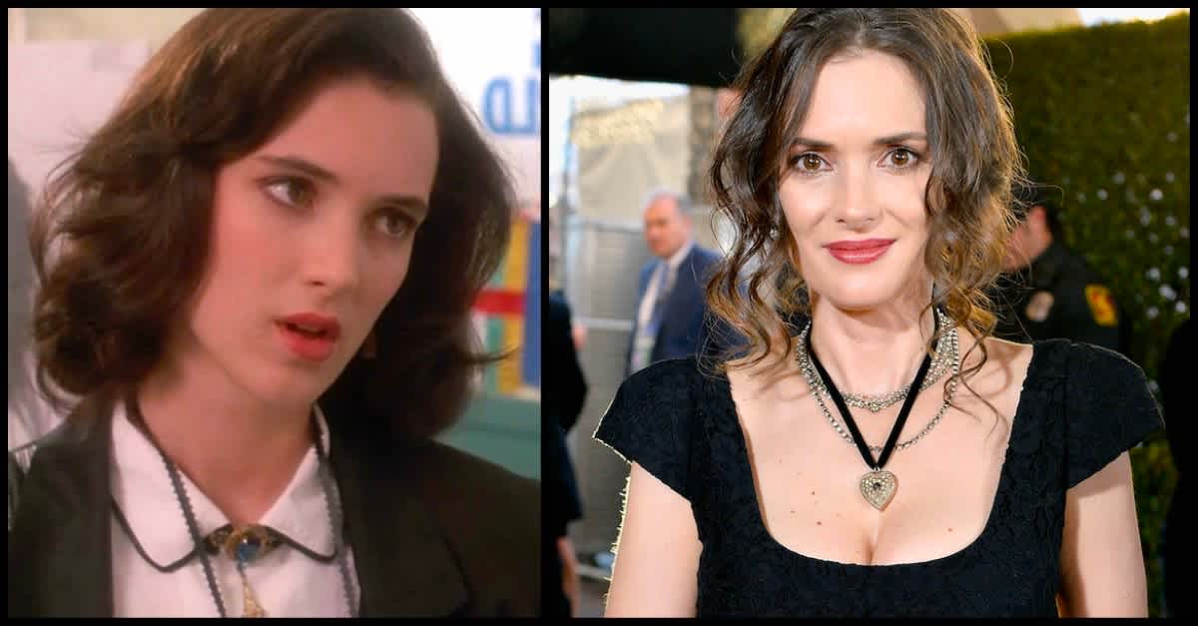
Benoit’s Image Repair Theory (Apologia)
Shifting Blame - Blames someone else for the offense
Winona Ryder: “My director instructed me to shoplift for a role I was preparing for.”

Slide 7
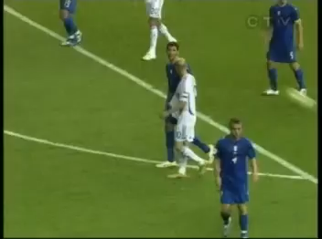
Benoit’s Image Repair Theory (Apologia)
Provocation - claims they were pushed into doing it
Zinedine Zidane: “I am a man and some words are harder to hear than actions. I would have rather taken a blow to the face than hear that.”

Slide 8
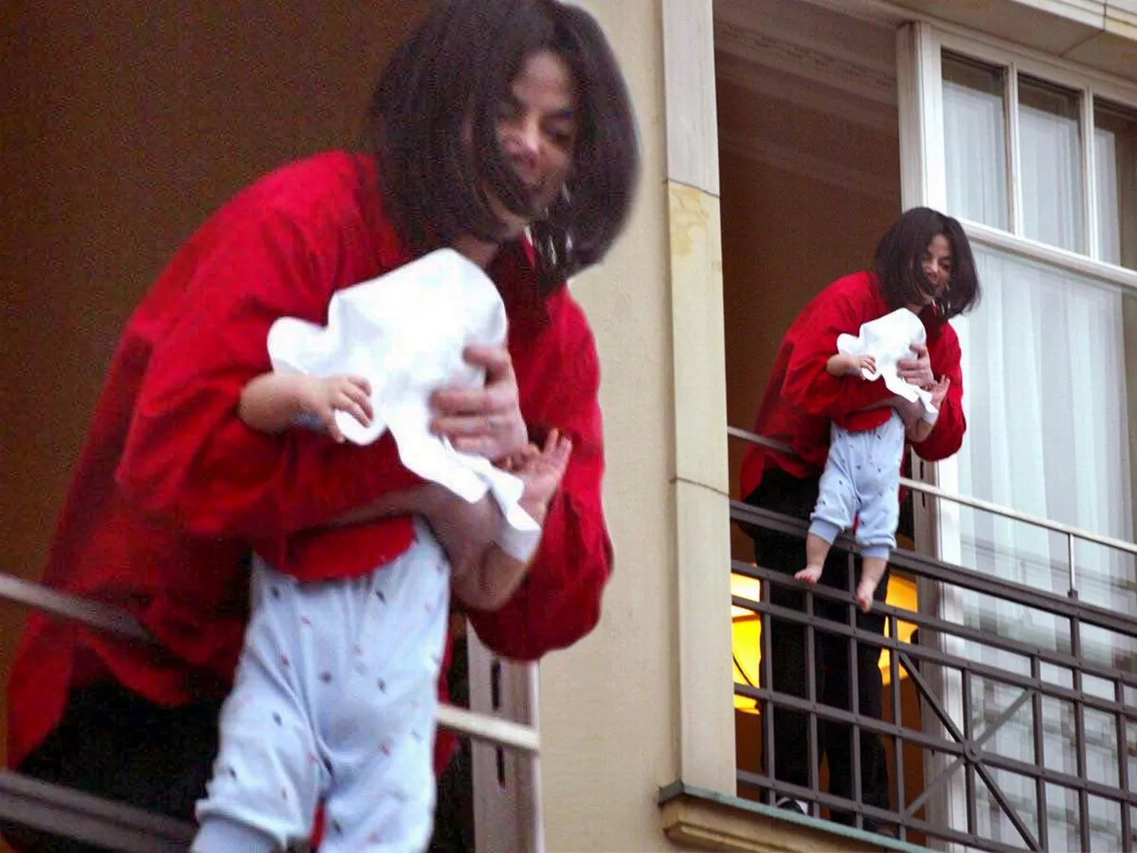
Benoit’s Image Repair Theory (Apologia)
Defeasibility - blame external non-human circumstances for their failure
Michael Jackson: “I got caught up in the excitement of the moment.”

Slide 9
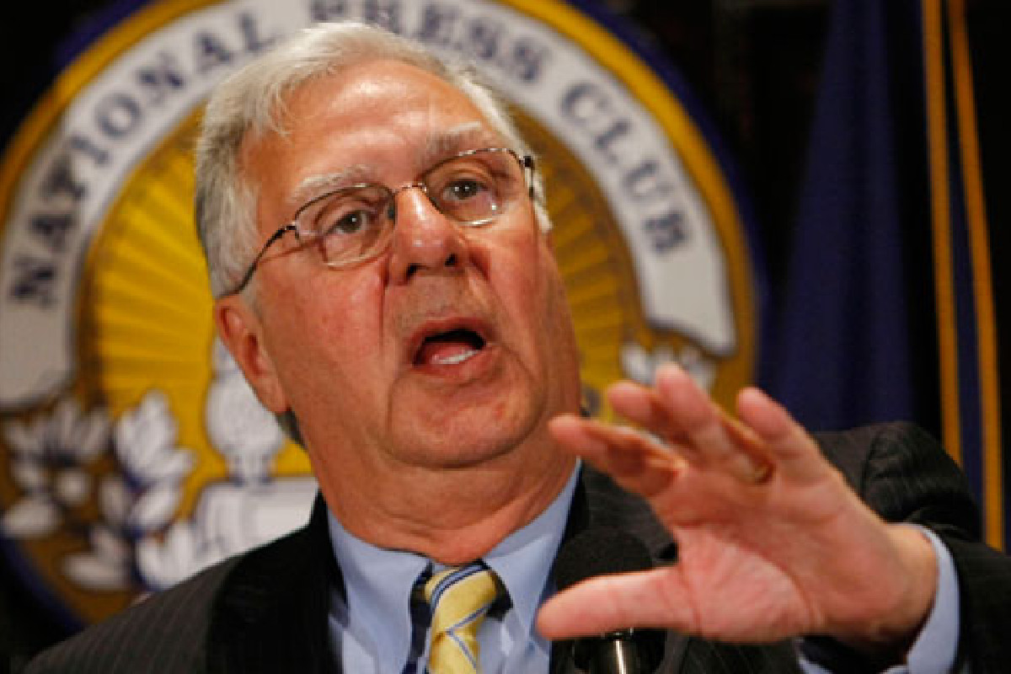
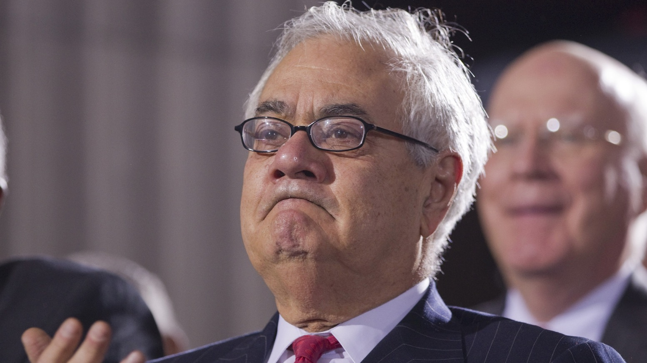
Benoit’s Image Repair Theory (Apologia)
Accident - claims they didn’t mean to do it
Rep. Dick Army: “This was nothing more than the unintentional mispronunciation of another person’s name that sounded like something it was not.”

Slide 10
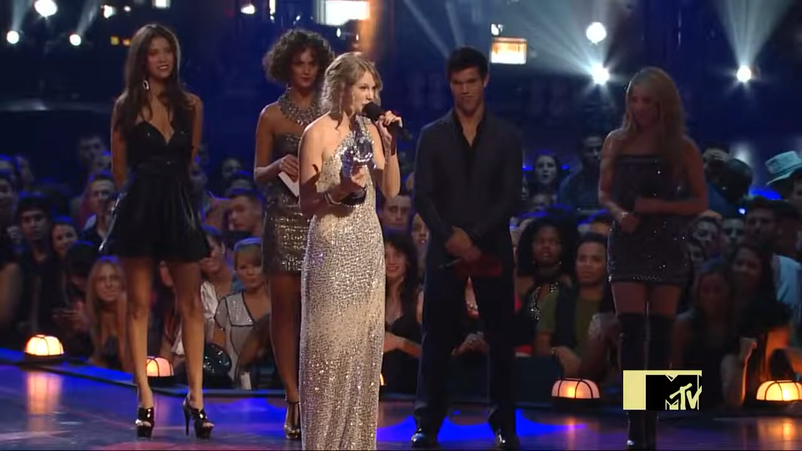
Benoit’s Image Repair Theory (Apologia)
Good Intentions - claims they meant well by their actions
Ye (formerly Kanye West): “Even in that moment, I was only trying to do good. But people don’t always need my help.”

Slide 11

Benoit’s Image Repair Theory (Apologia)
Bolstering - attempts to offset the harm by focusing on their positive qualities
Dominos Pizza CEO, Patrick Doyle: “We take tremendous pride in crafting delicious food.”

Slide 12
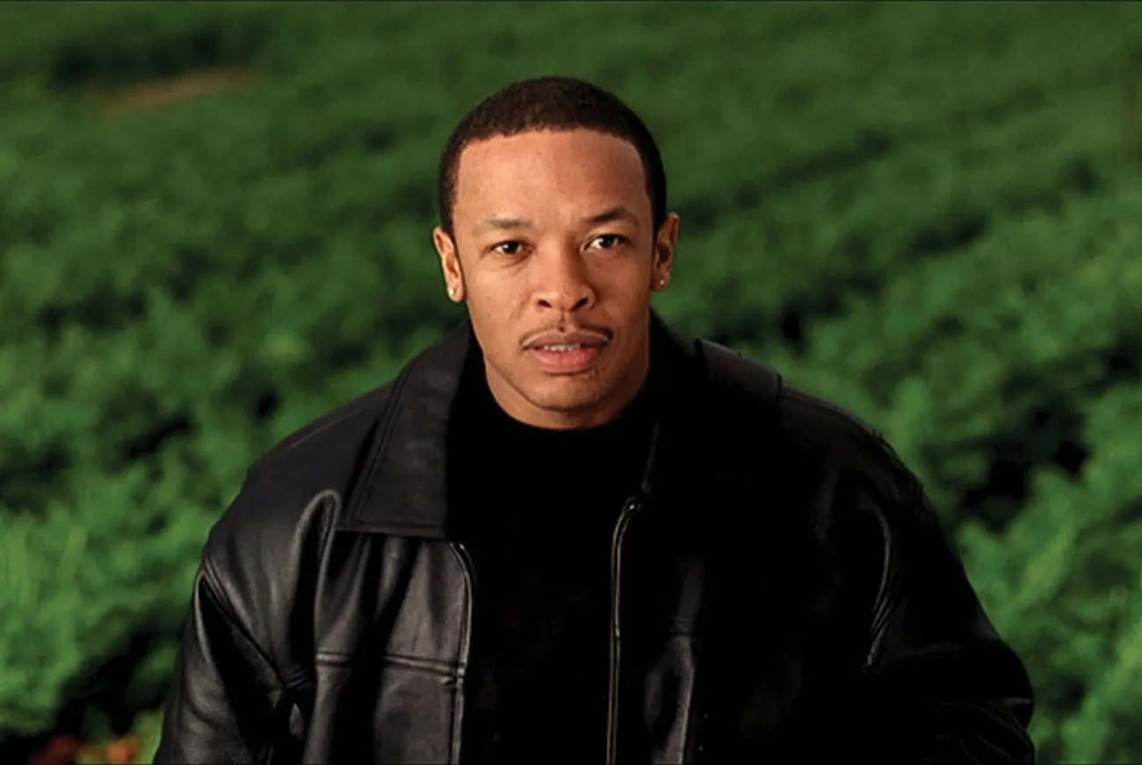
Benoit’s Image Repair Theory (Apologia)
Minimization - claims the offense wasn’t that bad
Dr. Dre: “Besides, it ain’t no big thing—I just threw her through a door.”

Slide 13
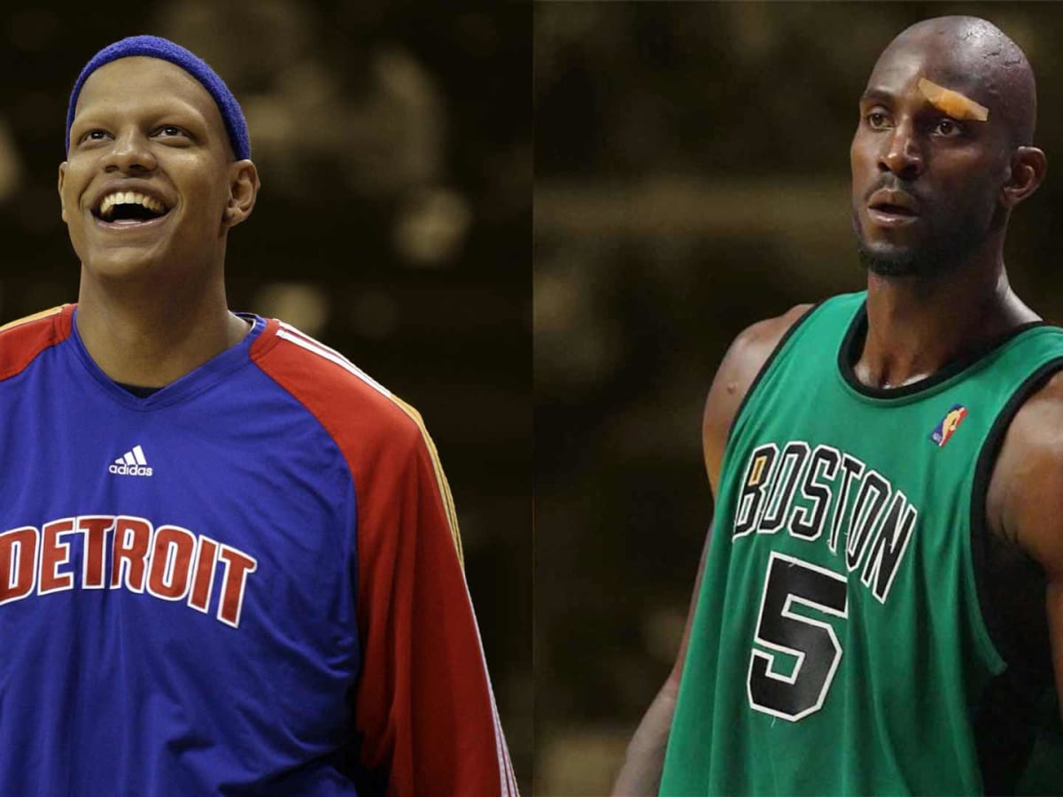
Benoit’s Image Repair Theory (Apologia)
Differentiation - attempts to distinguish the act from similar, but less desirable actions
Kevin Garnett: “My comment was in fact that he [Charlie Villanueva] was cancerous to the team and the league.”

Slide 14
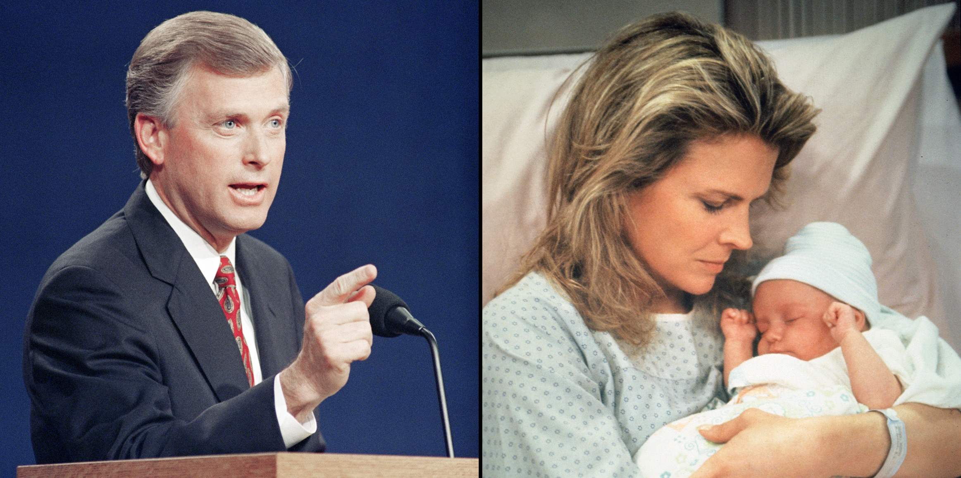
Benoit’s Image Repair Theory (Apologia)
Transcendence - placing the harmful act in a much more positive context
Dan Quayle: “It is time we put our children first. Our families and our nation depend on it.”

Slide 15
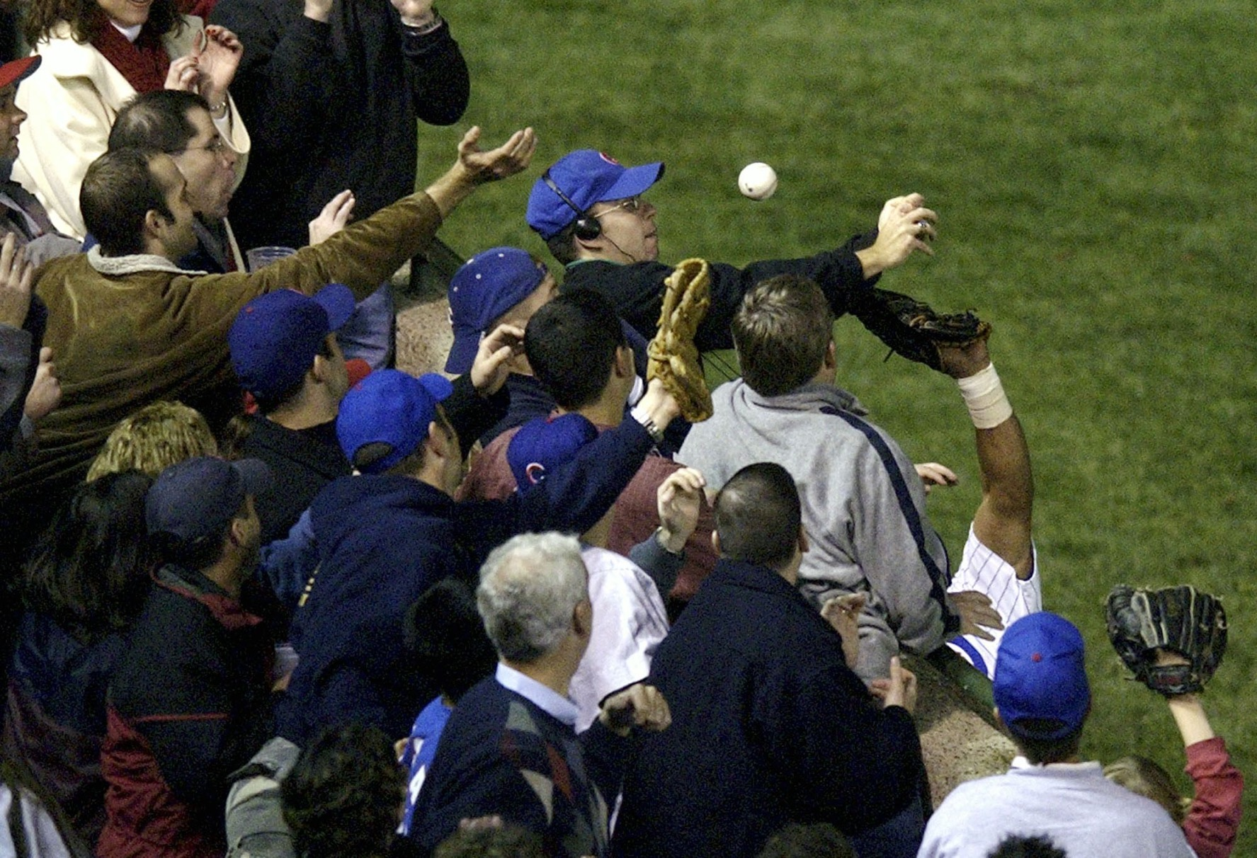
Benoit’s Image Repair Theory (Apologia)
Attacking the Accuser - lashing out at those who issued the attack
Steve Bartman: “ I ask that Cubs fans everywhere redirect the negative energy that has been vented towards my family, my friends, and myself into the usual positive support for our beloved team.”

Slide 16
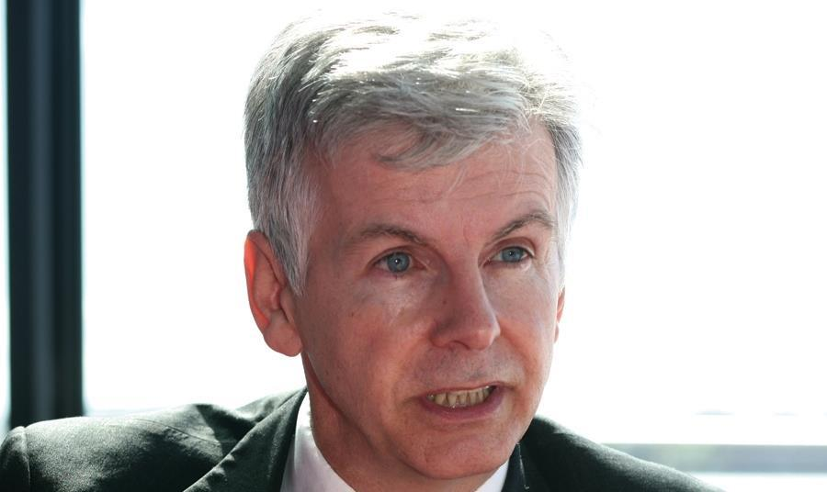
Benoit’s Image Repair Theory (Apologia)
Compensation - offering a payoff to victims to offset negative harm
One example is Mike O’Brien, British Health Minister, who offered £20 million to the victims who took thalidomide in the 1960s for morning sickness, leading to birth defects.

Slide 17
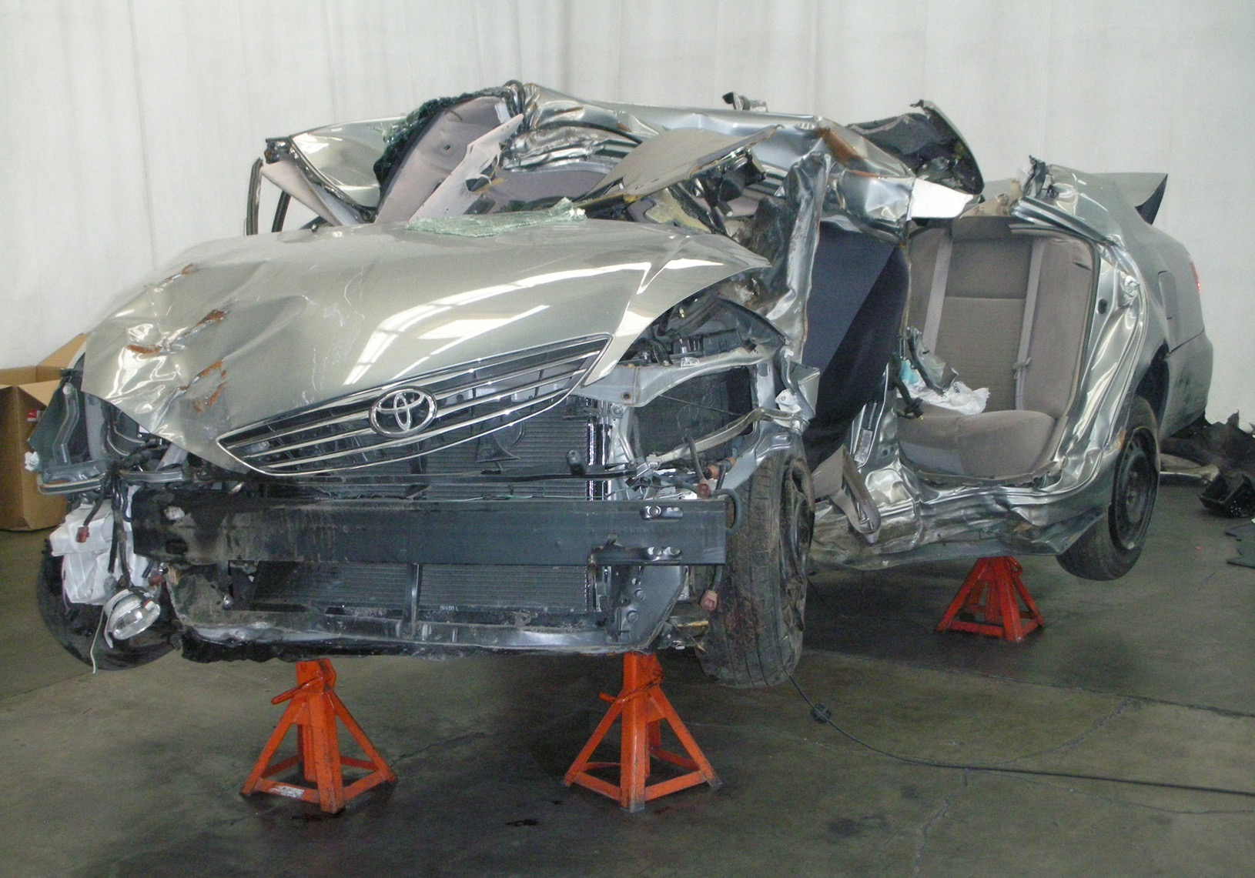
Benoit’s Image Repair Theory (Apologia)
Corrective Action - Offering to fix the damage that was caused
Jim Lentz, then-President of Toyota: “I want you to know that all 172,000 Toyota and dealership employees across America will work hard to fix your vehicle properly and regain your trust.”

Slide 18
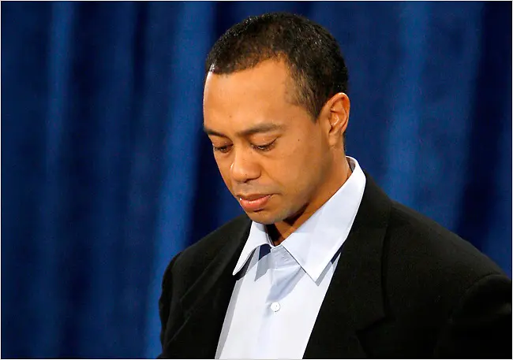
Benoit’s Image Repair Theory (Apologia)
Mortification - taking responsibility for the harm caused
Tiger Woods: “I want to say to each of you, simply and directly. I am deeply sorry for my irresponsible and selfish behavior I engaged in.”

Slide 19
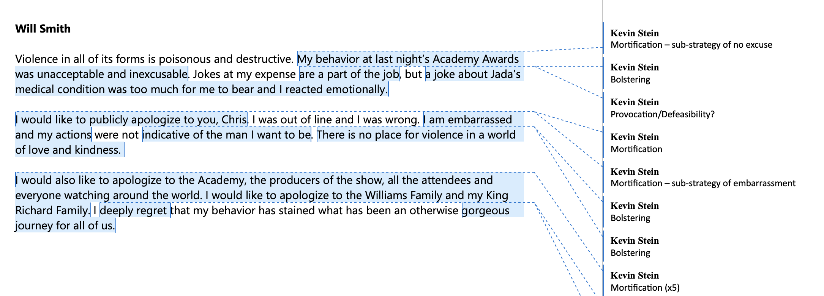
Image Repair Patterns
Content Analysis
  409 different contexts/Over 2,000 different image repair strategies
  Variables examined: Decade, context, gender, dissemination type, self vs surrogate, type of offense, and overall strategies.
  Coded by theme
  Reliability checks between coders

Slide 20
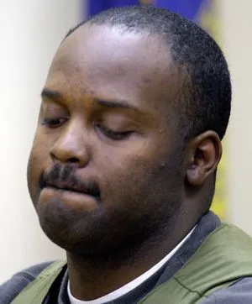
Image Repair Patterns
Overall Strategies
  Most represented: Mortification (34%), Bolstering (14%), and Corrective Action (12%)
  Least represented: Provocation (1%), Differentiation (2%)
“I’ve caused much grief. You are right. I did not do my job. I can only apologize for that.”
-Ray Brent Marsh

Slide 21
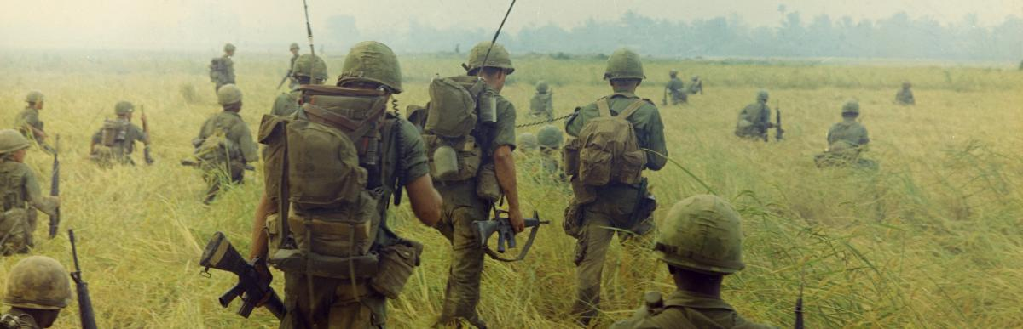
Image Repair Patterns
Strategies by Decade
  Certain decades lent themselves to certain strategies, such as transcendence in the 1970s and bolstering in the 1950s.
  Since the 1980s, mortification has been consistently the most used strategy in each decade

Slide 22
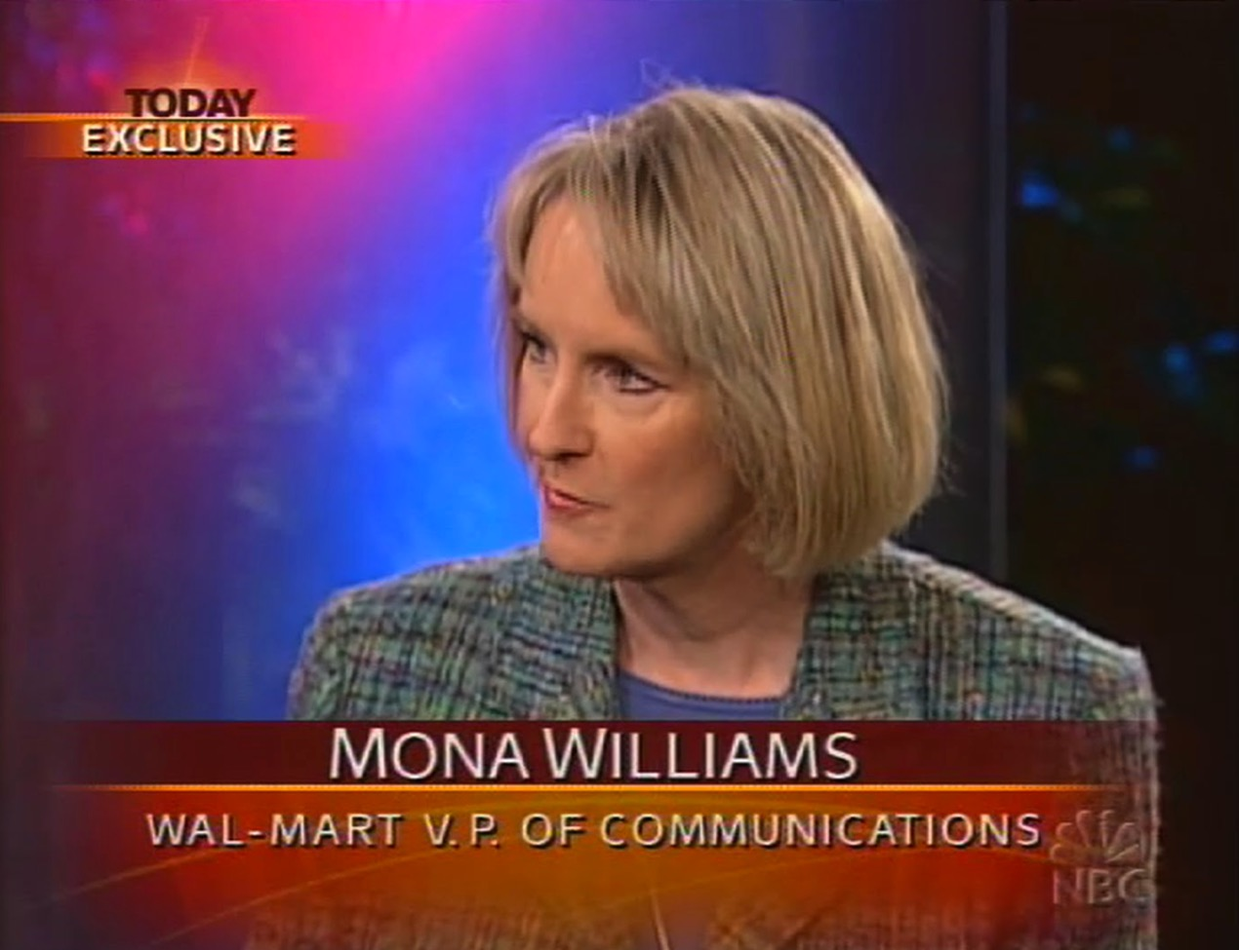
Image Repair Patterns
Strategies by Context
  Organizations used more corrective action than any other individual or group
  Celebrities and athletes used mostly mortification
  Religious leaders of all denominations used more mortification than any other group
“We are heartsick that this happened and are currently doing everything possible to correct the problem.”
-Mona Williams

Slide 23
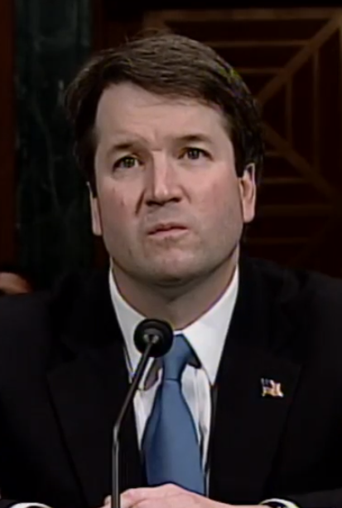
Image Repair Patterns
Strategies by Gender
  Women used mortification as a strategy more frequently than men
  Men engaged in bolstering more frequently than women
  Men and women were relatively equal on corrective action
  Men were more likely to use denial and to attack their accusers than women
“Since my nomination in July, there’s been a frenzy on the left to come up with something, anything to block my confirmation.”
-Brett Kavanaugh

Slide 24

Image Repair Patterns
Strategies by Dissemination Type
  More likely to use mortification in a press conference or interview than press releases, social media posts, or websites
  Website image repair focused heavily on corrective action

Slide 25
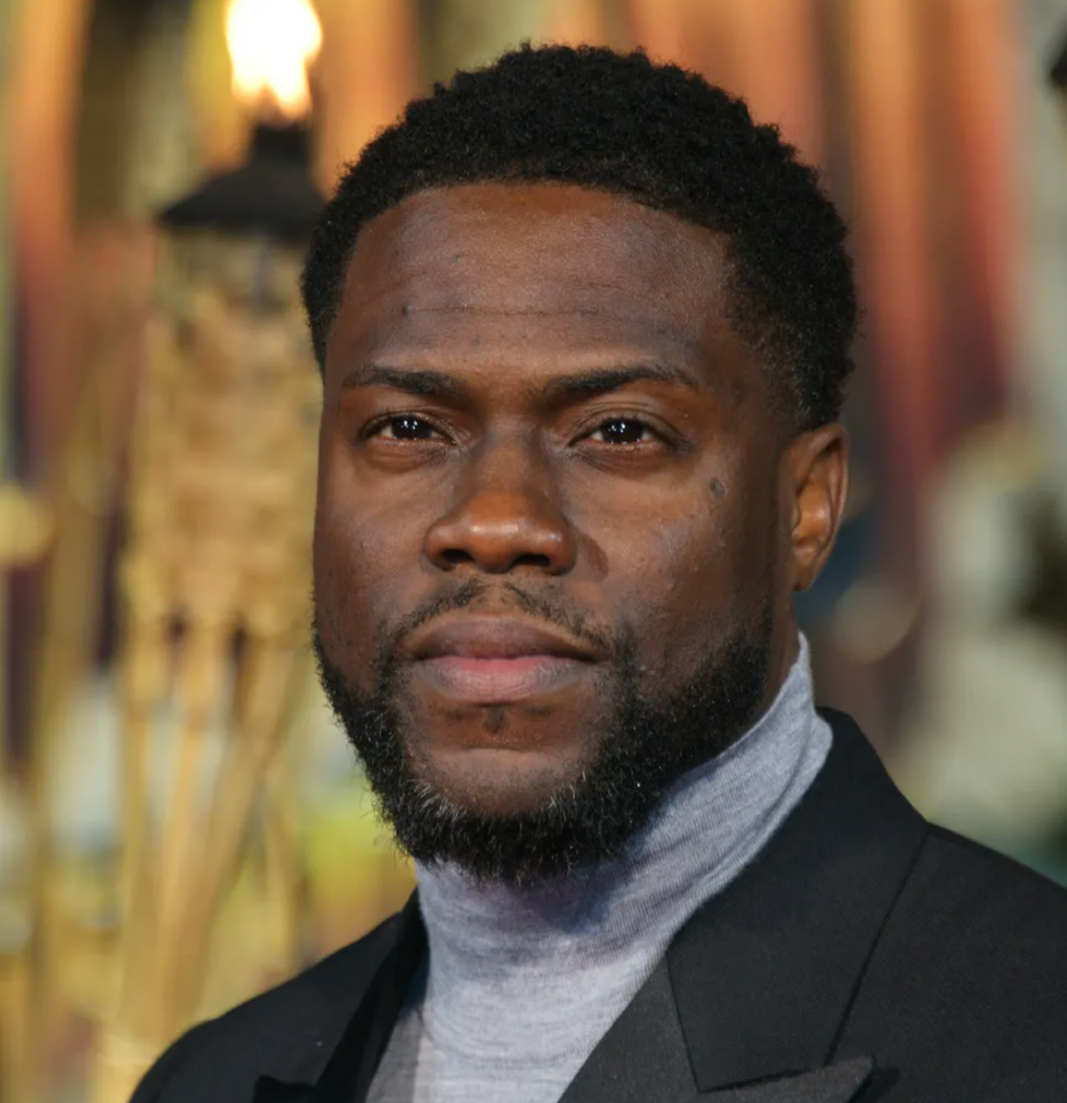
Image Repair Patterns
Self vs. Surrogate Apologia:
  Self image repair contained more mortification
  Surrogate image repair contained more denial, attacking the accuser, and bolstering
“This is no longer the world’s problem. It’s Will [Smith] and Chris’ [Rock] problem. The world should step out of it and let them recover.”
-Kevin Hart

Slide 26
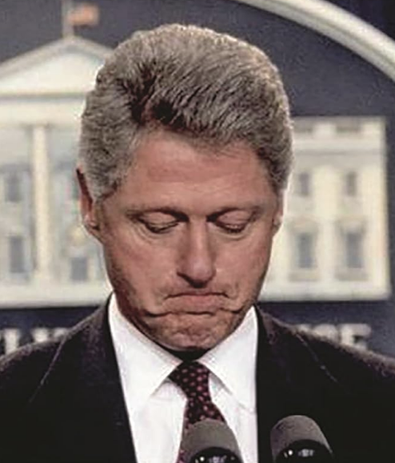
Image Repair Patterns
Gender and Offense
  Men had more infidelity offenses than women
  Men and women were equal in deception, drugs and alcohol, and racism

Slide 27
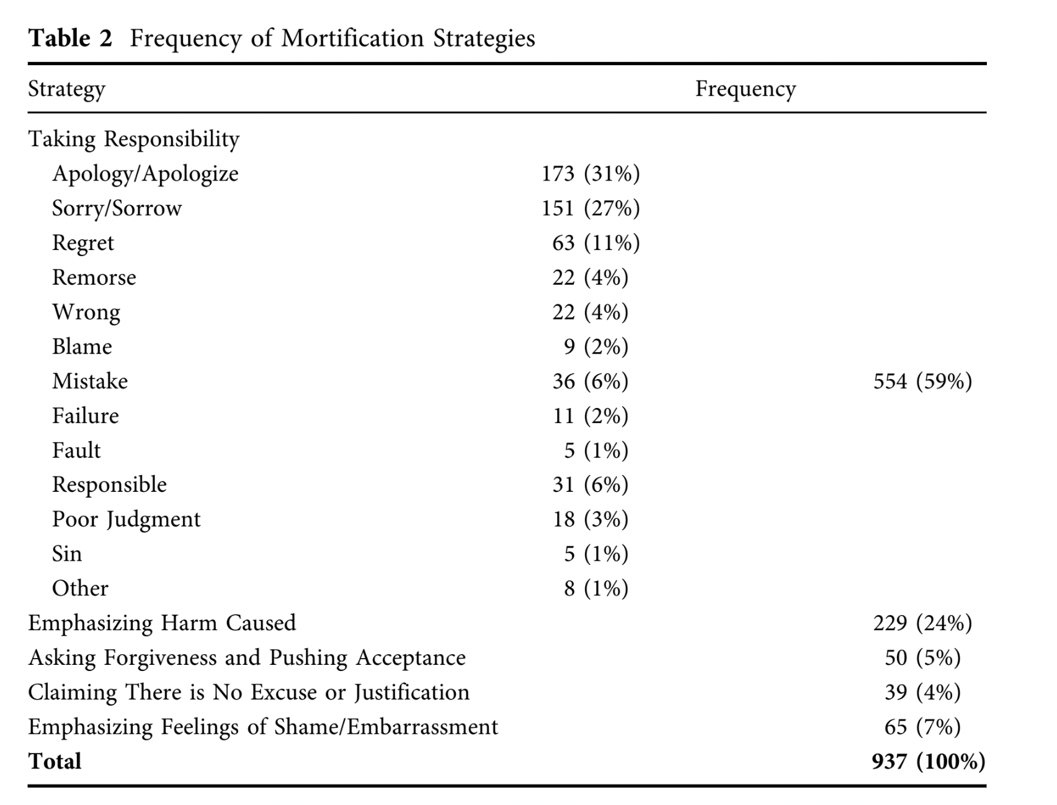
Image Repair Patterns

Slide 28
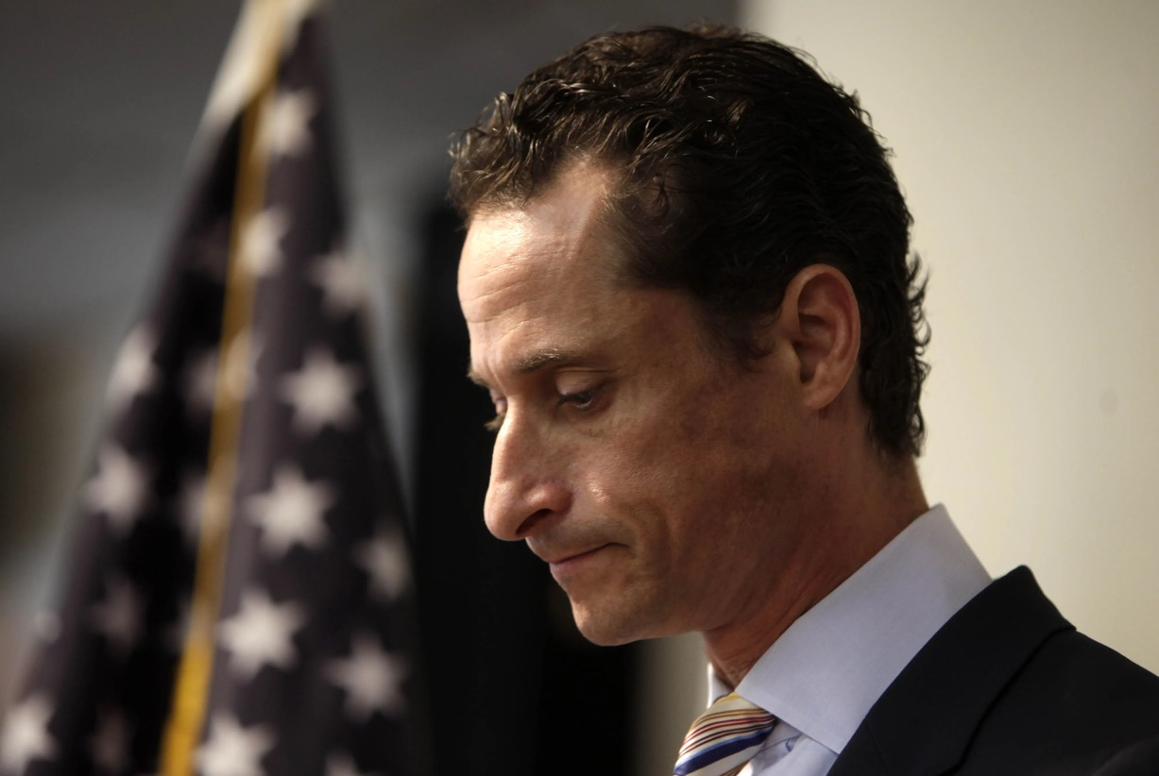
Conclusions
Technology has had a huge impact
  Increases the overall number of image repair efforts
  Increases the staying power of scandals
  Public “handlers” have become obsolete
  Social media has changed the content and form of image repair
  Creates more authentic image repair, but are the best strategies being used?

Slide 29
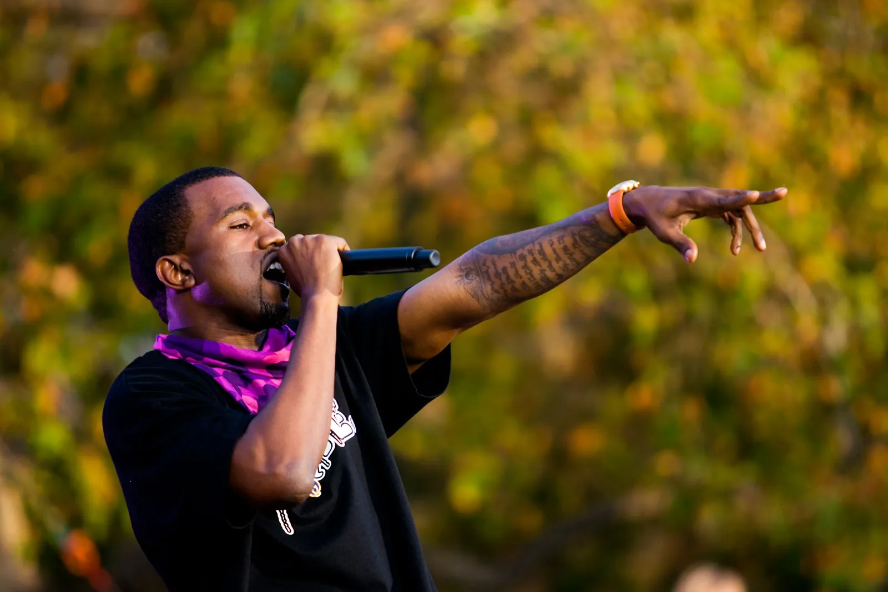
Kanye West and Social Media
Key Strategies:
  Mortification - “I knew immediately that it was wrong.”
  Good Intentions - “Even in that moment, I was only trying to do good.”
  Corrective action - “If there is anything I could do to help Taylor Swift in the future…”

Slide 30
Kanye West and Social Media
The Jay Leno interview is much different from his social media
  Leno Interview - “My entire life, I’ve only wanted to give and do something that I felt was right. And I immediately knew in this situation that it was wrong and it wasn’t a spectacle it’s actually someone’s emotions, you know, that I stepped on.”
  West’s Blog - “I’m sorry to my fans if I let you guys down! I’m sorry to my friends at mtv. I will apologize to taylor 2mrw. welcome to the real world! everybody wanna booooo me but i’m a fan of real pop culture! No disrespect but we watchin’ the show at the crib right now cause … well you know! i’m still happy for taylor! Boooyaaawwww!

Slide 31

Laura Lee and YouTube
Key Strategies:
  Mortification - “I have no excuses. I’m only here to say I’m sorry.”
  Bolstering - “I am better than that person…I can prove to you guys that I’m not that girl.”
  Attacking the Accuser - “People have called my mother and threatened to kill her.”

Slide 32
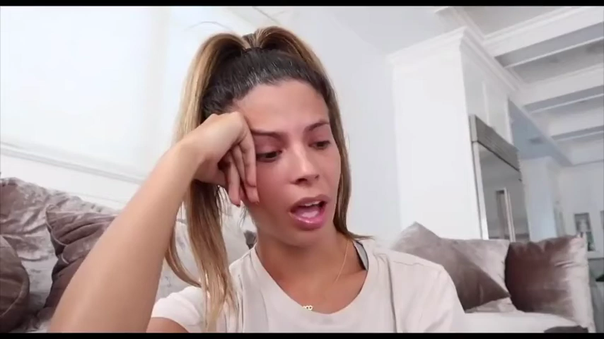
Laura Lee and YouTube

Slide 33

Conclusions
We deal with patterns and not rules - We need to be careful with our judgments
Data is skewed because of the prominence of men in public life
The best strategies are generally authentic mortification and corrective action
Uniqueness of offenses makes it difficult to anticipate appropriate strategies
Ample opportunities for future research

Slide 34
Thank You
Are there any questions?

